Slide 1
An Introduction to Artificial Intelligence
Chapter 13 &14.1-14.2: Uncertainty & Bayesian Networks
Ramin Halavati
(halavati@ce.sharif.edu)

Slide 2
Outline
Uncertainty
Probability
Syntax and Semantics
Inference
Independence and Bayes' Rule
Bayesian Network

Slide 3
Uncertainty
Let action A_{t} = leave for airport _{t} minutes before flight
Will A_{t} get me there on time?
Problems:
  partial observability (road state, other drivers' plans, etc.)
  noisy sensors (traffic reports)
  uncertainty in action outcomes (flat tire, etc.)
  immense complexity of modeling and predicting traffic
Hence a purely logical approach either
  risks falsehood: “A₂₅ will get me there on time”, or
  leads to conclusions that are too weak for decision making:
“A₂₅ will get me there on time if there's no accident on the bridge and it doesn't rain and my tires remain intact etc etc.”
(A₁₄₄₀ might reasonably be said to get me there on time but I'd have to stay overnight in the airport …)

Slide 4
Methods for handling uncertainty
Default or nonmonotonic logic:
  Assume my car does not have a flat tire
  Assume A₂₅ works unless contradicted by evidence
Issues: What assumptions are reasonable? How to handle contradiction?
Rules with fudge factors:
  A₂₅ |→_{0.3} get there on time
  Sprinkler |→ _{0.99} WetGrass
  WetGrass |→ _{0.7} Rain
Issues: Problems with combination, e.g., Sprinkler causes Rain??
Probability
  Model agent's degree of belief
  Given the available evidence,
  A₂₅ will get me there on time with probability 0.04

Slide 5
Probability
Probabilistic assertions summarize effects of
  laziness: failure to enumerate exceptions, qualifications, etc.
  ignorance: lack of relevant facts, initial conditions, etc.
Subjective probability:
Probabilities relate propositions to agent's own state of knowledge
e.g., P(A₂₅ | no reported accidents) = 0.06
These are not assertions about the world
Probabilities of propositions change with new evidence:
e.g., P(A₂₅ | no reported accidents, 5 a.m.) = 0.15

Slide 6
Making decisions under uncertainty
Suppose I believe the following:
  P(A₂₅ gets me there on time | …) = 0.04
  P(A₉₀ gets me there on time | …) = 0.70
  P(A₁₂₀ gets me there on time | …) = 0.95
  P(A₁₄₄₀ gets me there on time | …) = 0.9999
Which action to choose?
Depends on my preferences for missing flight vs. time spent waiting, etc.
  Utility theory is used to represent and infer preferences
  Decision theory = probability theory + utility theory

Slide 7
Syntax
Basic element: random variable
Similar to propositional logic: possible worlds defined by assignment of values to random variables.
Boolean random variables
  e.g., Cavity (do I have a cavity?)
Discrete random variables
  e.g., Weather is one of <sunny,rainy,cloudy,snow>
Domain values must be exhaustive and mutually exclusive
Elementary proposition constructed by assignment of a value to a
Complex propositions formed from elementary propositions and standard logical connectives e.g., Weather = sunny ∨ Cavity = false
random variable: e.g., Weather = sunny, Cavity = false
(abbreviated as ➢cavity)

Slide 8
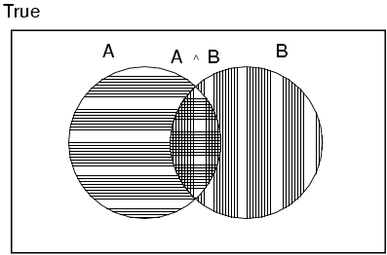
Axioms of probability
For any propositions A, B
  0 ≤ P(A) ≤ 1
  P(true) = 1 and P(false) = 0
  P(A ∨ B) = P(A) + P(B) - P(A ∧ B)

Slide 9
Prior probability
Prior or unconditional probabilities of propositions
  e.g., P(Cavity = true) = 0.1 and P(Weather = sunny) = 0.72 correspond to belief prior to arrival of any (new) evidence
Joint probability distribution for a set of random variables gives the probability of every atomic event on those random variables
  P(Weather,Cavity) = a 4 × 2 matrix of values:
Weather = sunny rainy cloudy snow
Cavity = true 0.144 0.02 0.016 0.02
Cavity = false 0.576 0.08 0.064 0.08
Every question about a domain can be answered by the joint distribution

Slide 10

Inference by Numeration
Start with the joint probability distribution:
For any proposition φ, sum the atomic events where it is true: P(φ) = Σ_{ω:ω╞φ} P(ω)

Slide 11

Inference by enumeration
Start with the joint probability distribution:
Can also compute conditional probabilities:
P(¬cavity | toothache)
= P(¬cavity ∧ toothache)
P(toothache)
= 0.016+0.064
0.108 + 0.012 + 0.016 + 0.064
= 0.4

Slide 12
Conditional probability
Conditional or posterior probabilities
  e.g., P(cavity | toothache) = 0.8
  i.e., given that toothache is all I know
New evidence may be irrelevant, allowing simplification, e.g.,
  P(cavity | toothache, sunny) = P(cavity | toothache) = 0.8

Slide 13
Conditional probability
Definition of conditional probability:
  P(a | b) = P(a ∧ b) / P(b) if P(b) > 0
Product rule gives an alternative formulation:
  P(a ∧ b) = P(a | b) P(b) = P(b | a) P(a)
Chain rule is derived by successive application of product rule:
  P(X₁, …,X_{n})
  = P(X₁,...,X_{n-1}) P(X_{n} | X₁,...,X_{n-1})
  = P(X₁,...,X_{n-2}) P(X_{n-1} | X₁,...,X_{n-2}) P(X_{n} | X₁,...,X_{n-1})
  = …
  = π_{i= 1}^n P(X_{i} | X₁, … ,X_{i-1})

Slide 14
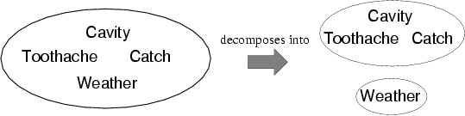
Independence
A and B are independent iff
P(A|B) = P(A) or P(B|A) = P(B) or P(A, B) = P(A) P(B)
  P(Toothache, Catch, Cavity, Weather)
  = P(Toothache, Catch, Cavity) P(Weather)
32 entries reduced to 12; for n independent biased coins, O(2^{n}) →O(n)

Slide 15
Bayes' Rule
P(a∧b) = P(a | b) P(b) = P(b | a) P(a)
⇒ Bayes' rule: P(a | b) = P(b | a) P(a) / P(b)
Useful for assessing diagnostic probability from causal probability:
  P(Cause|Effect) = P(Effect|Cause) P(Cause) / P(Effect)
  E.g., let M be meningitis, S be stiff neck:
    P(m|s) = P(s|m) P(m) / P(s) = 0.8 × 0.0001 / 0.1 = 0.0008
  Note: posterior probability of meningitis still very small!

Slide 16
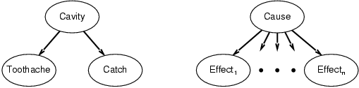
Bayes' Rule and conditional independence
P(Cavity | toothache ∧ catch)
  = αP(toothache ∧ catch | Cavity) P(Cavity)
  = αP(toothache | Cavity) P(catch | Cavity) P(Cavity)
This is an example of a naïve Bayes model:
  P(Cause,Effect₁, … ,Effect_{n}) = P(Cause) π_{i}P(Effect_{i}|Cause)
Total number of parameters is linear in n

Slide 17
Bayesian networks
A simple, graphical notation for conditional independence assertions and hence for compact specification of full joint distributions
Syntax:
  a set of nodes, one per variable
  a directed, acyclic graph (link ≈ "directly influences")
  a conditional distribution for each node given its parents:
    P (X_{i} | Parents (X_{i}))
In the simplest case, conditional distribution represented as a conditional probability table (CPT) giving the distribution over X_{i} for each combination of parent values

Slide 18

Example
Topology of network encodes conditional independence assertions:
Weather is independent of the other variables
Toothache and Catch are conditionally independent given Cavity

Slide 19
Example
I'm at work, neighbor John calls to say my alarm is ringing, but neighbor Mary doesn't call. Sometimes it's set off by minor earthquakes. Is there a burglar?
Variables: Burglary, Earthquake, Alarm, JohnCalls, MaryCalls
Network topology reflects "causal" knowledge:
  A burglar can set the alarm off
  An earthquake can set the alarm off
  The alarm can cause Mary to call
  The alarm can cause John to call

Slide 20
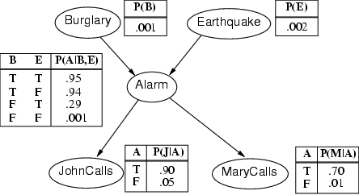
Example contd.

Slide 21
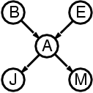
Compactness
A CPT for Boolean X_{i} with k Boolean parents has 2^{k} rows for the combinations of parent values
Each row requires one number p for X_{i} = true
(the number for X_{i} = false is just 1-p)
If each variable has no more than k parents, the complete network requires O(n · 2^{k}) numbers
I.e., grows linearly with n, vs. O(2^{n}) for the full joint distribution
For burglary net, 1 + 1 + 4 + 2 + 2 = 10 numbers (vs. 2⁵-1 = 31)

Slide 22
Semantics
The full joint distribution is defined as the product of the local conditional distributions:
P (X₁, … ,X_{n}) = π_{i = 1} P (X_{i} | Parents(X_{i}))
e.g., P(j ∧ m ∧ a ∧ ¬b ∧ ¬e)
= P (j | a) P (m | a) P (a | ¬b, ¬e) P (¬b) P (¬e)
n

Slide 23
Constructing Bayesian networks
Choose an ordering of variables X₁, … ,X_{n}
For i = 1 to n
  add X_{i} to the network
  select parents from X₁, … ,X_{i-1} such that
  P (X_{i} | Parents(X_{i})) = P (X_{i} | X₁, ... X_{i-1})
This choice of parents guarantees:
P (X₁, … ,X_{n}) = π_{i =1} P (X_{i} | X₁, … , X_{i-1})
= π_{i =1}P (X_{i} | Parents(X_{i}))
(by construction)
(chain rule)
n
n

Slide 24
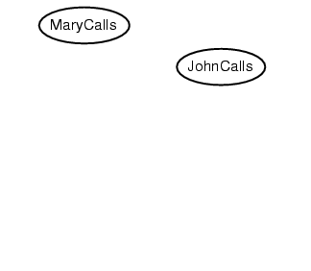
Example
Suppose we choose the ordering M, J, A, B, E
P(J | M) = P(J)?

Slide 25
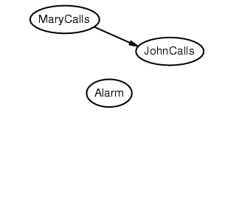
Example
Suppose we choose the ordering M, J, A, B, E
P(J | M) = P(J)?
P(A | J, M) = P(A | J)? P(A | J, M) = P(A)?
No

Slide 26
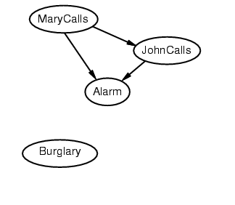
Example
Suppose we choose the ordering M, J, A, B, E
P(J | M) = P(J)?
P(A | J, M) = P(A | J)? P(A | J, M) = P(A)? No
P(B | A, J, M) = P(B | A)?
P(B | A, J, M) = P(B)?
No

Slide 27
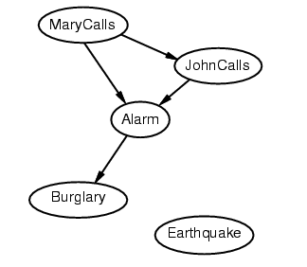
Example
Suppose we choose the ordering M, J, A, B, E
P(J | M) = P(J)?
P(A | J, M) = P(A | J)? P(A | J, M) = P(A)? No
P(B | A, J, M) = P(B | A)? Yes
P(B | A, J, M) = P(B)? No
P(E | B, A ,J, M) = P(E | A)?
P(E | B, A, J, M) = P(E | A, B)?
No

Slide 28
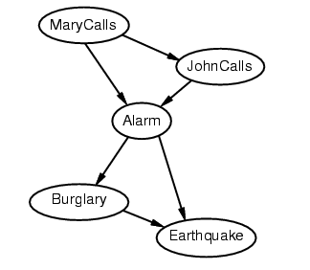
Example
Suppose we choose the ordering M, J, A, B, E
P(J | M) = P(J)?
P(A | J, M) = P(A | J)? P(A | J, M) = P(A)? No
P(B | A, J, M) = P(B | A)? Yes
P(B | A, J, M) = P(B)? No
P(E | B, A ,J, M) = P(E | A)? No
P(E | B, A, J, M) = P(E | A, B)? Yes
No

Slide 29
Example contd.
Deciding conditional independence is hard in noncausal directions
(Causal models and conditional independence seem hardwired for humans!)
Network is less compact: 1 + 2 + 4 + 2 + 4 = 13 numbers needed

Slide 30
Summary
Probability is a rigorous formalism for uncertain knowledge
Joint probability distribution specifies probability of every atomic event
Queries can be answered by summing over atomic events
For nontrivial domains, we must find a way to reduce the joint size
Independence and conditional independence provide the tools

Slide 31
Summary
Bayesian networks provide a natural representation for (causally induced) conditional independence
Topology + CPTs = compact representation of joint distribution
Generally easy for domain experts to construct

